Slide 1
Learning aim D: Examine business markets
Unit 1 Exploring Business-Learning Aim C and D
Key points to include in your assignment:
Do they have a competitive advantage?
Evaluate how their market structure influences the supply and demand.
Have there been any changes and how have they reacted?
Any ethical or environmental issues?
D1 Different market structures
Market structures: perfect competition, imperfect competition.
Features of different market structures: number of firms, freedom of entry,nature of product.

Slide 2
Perfect Competition has the following features.
All firms sell an identical product.
They are Price takers.
All firms have a relatively small market share.
Buyers know the product and the prices being charged by firms.
In the Industry there is both freedom of entry and can leave easily.
https://www.youtube.com/watch?v=aFBGsad_qE0.
Businesses all supply exactly the same product.
If Suppliers can manufacture their own brands they can be more competitive.
If businesses wish to maintain or increase their market share, they need to differentiate their products, by such aspects of quality or customer service.
There are no barriers to entry.

Slide 3
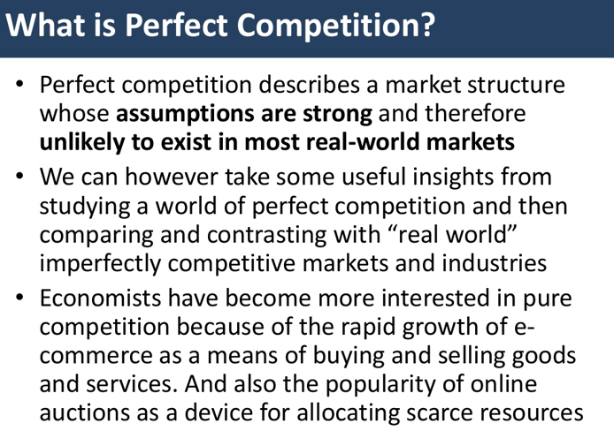
Perfect Competition.
Students should be able to:
Understand the assumptions of perfect competition and be able to explain the behaviour of firms in this market structure.
Understand the significance of firms as price-takers in perfectly competitive markets. An understanding of the meaning of shut-down point is required.
The impact of entry into and exit from the industry should be considered.
https://www.tutor2u.net/economics/reference/perfect-competition-revision-presentation

Slide 4
Understanding Imperfect Competition
Less Competition than in a Perfect Competition market structure.
Products may not be identical meaning that businesses can set their own prices.
https://www.tutor2u.net/economics/reference/understanding-imperfect-competition
This video provides an overview of three forms of imperfect competition, namely monopoly, oligopoly and imperfect competition. It considers too the likely impact of each market structure on allocative, productive and dynamic efficiency.
View our full revision playlist on monopolistic competition over on the Tutor2u Youtube Channel:
https://www.youtube.com/playlist?list=PLp8BSCLLWBUB5QT-yQHuqi1U11BkTbUAa

Slide 5
Perfect Competition v Imperfect Competition
 | Perfect Competition | Imperfect Competition
Numbers of sellers | many | Varies not identical
Barriers to entry | None | significant
Substitutes | None | Many
Nature of Competition | Price Only | Price and quality etc
Pricing power | None | Possibly significant

Slide 6
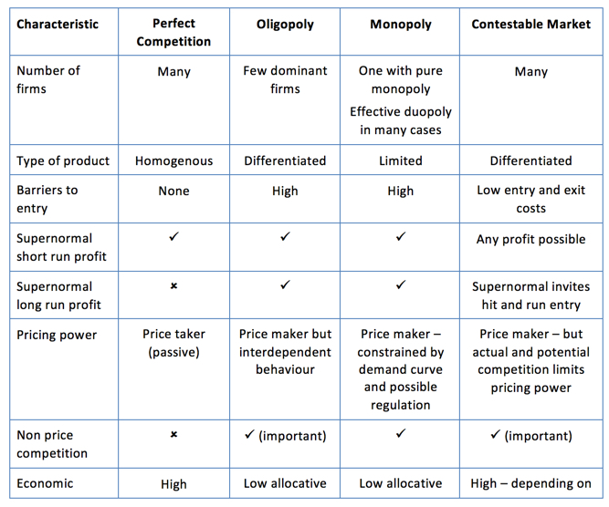
Key Summary on Market Structures
Market structure is best defined as the organisational and other characteristics of a market.
We focus on those characteristics which affect the nature of competition and pricing – but it is important not to place too much emphasis simply on the market share of the existing firms in an industry.
https://www.tutor2u.net/economics/reference/key-summary-on-market-structures

Slide 7
Important questions to answer in your assignment 2.
How can a business compete in a perfect Competition structure?
How can businesses gain market share?
Does Imperfect Competition allow more flexibility for freedom of entry?
Does the product determine the market structure.?
Do products also determine freedom of entry, numbers of competitors, can the environment sustain the market share.
What happens to businesses that sell similar products at similar prices? How can they survive?
Think of examples of businesses that have failed to survive and why they have failed.
Businesses with a perfect competition structure are too small to influence changes to prices because of the small market share.
Imperfect competition structure can influence pricing by forcing suppliers to reduce costs when demand increases.

Slide 8
Exemplar work for Learning aim D.
The following achieved P6 and M4.
The learner gives a brief outline of the features of oligopoly and shows an understanding of supply and demand.
The learner goes on to explore the changes in the wider chocolate confectionary market and how Cadbury is affected.

Slide 9
How Cadbury is affected by the business environment
An oligopoly is a market structure dominated by a small number of sellers (oligopolists). This includes the confectionery market and so it affects Cadbury. In an oligopoly each seller has a large market share, and tends to compete on non‐price factors. This results in reduced competition and lead to higher costs for consumers. An oligopoly has the ability to change the market. Cadbury and other top chocolate companies have a large effect and hold over the market. They can adjust the pricing of chocolate, and can ultimately affect the chocolate industry. If, for example, Cadbury were to lower their prices in order to have a larger amount of customers it would receive a lower revenue and so less profit as costs would not change. This would have a knock on affect for other firms within the oligopoly because they would then have to lower their prices in order to compete with Cadbury’s low prices or keep their prices the same and hope that it wouldn’t affect them.
Any company that lowers their prices or make a large change to the market would affect each company in the oligopoly.
The pricing of Cadbury products can be affected in many ways. For example, the pricing could change depending on supply and price which includes the elasticity of demand. As a brand leader Cadbury has good consumer loyalty and demand is relatively inelastic. This means regardless of a minor increase in price, the demand of the good will remain the same. However the wider market demand for chocolate is more elastic, meaning other consumers will react to price changes. If there is a minor decrease in Cadbury’s price, the demand for its goods may rise as consumers move from competitors. The prices of the products of competitors such as Nestlé have an immediate effect on their demand. When the prices of its products are high, the demand of Cadbury’s products will increase as consumers move to Cadbury.

Slide 10
The main threat of substitutes for Cadbury and any other confectionary brand are supermarket own brands.
This is because they tend to copy popular chocolates and sell them at a lower price thus lowering Cadbury’s
revenue. The suppliers play a massive part in the pricing because they can affect the price of which it is later sold for
via Cadbury. Cadbury relies heavily on cocoa beans to manufacture its products, and this is a crop that varies
in quantity and price year on year. The following graph shows the cocoa bean production by year in
different countries.
The graph shows that gradually year by year the production of cocoa beans is increasing, however there is problems which are affecting the production rates each year. There have been disease outbursts in
numerous countries in Africa which would affect the production rates. Therefore, I believe in 2016 we will
see a decrease in cocoa bean production because of these disease outbursts, and there will then be a knock
on effect.

Slide 11
The graph shows that gradually year by year the production of cocoa beans is increasing, however there is problems which are affecting the production rates each year. There have been disease outbursts in numerous countries in Africa which would affect the production rates. Therefore, I believe in 2016 we will see a decrease in cocoa bean production because of these disease outbursts, and there will then be a knock
on effect.
When there is a shortage of cocoa in Africa this would ultimately affect Cadbury and any chocolate based production company because with the shortage of cocoa everywhere the suppliers selling the cocoa will increase the price at which they sell it. This is possible because with a shortage or limited supply the big companies won’t have much choice as to where to buy it from. An increase in costs will always have a negative impact on a business and very often the business will pass on the increase in their costs to the customer by an increase in the selling price. As a large company Cadbury has large buying power and can benefit from economies of scale.
Customers in the confectionary market have a choice, and an increase in the price of the products can lead to customers switching to its competitors. Cadburys would be taking a risk as if it increases the price it sells its product at it might face losing customers to competitors, but it may do so in an attempt to maintain the same profit as it would have received before the shortage of cocoa. The risk is therefore a price increase leading to a loss in revenue.

Slide 12
An alternative to this would be to keep its selling prices the same which would increase revenue. Rival chocolate based companies such as Nestlé may also decide to increase prices to maintain their profit. Not passing on the increase costs would however lead to a lower profit as Cadburys would be paying more for their product and selling it on for what they previously did before the shortage of cocoa. In recent years Cadburys have decided to change the size of their chocolate products and many of these are smaller due to increasing costs such as an increase in the price of cocoa, increase of labour costs, increased transport costs, etc. It has made the standard size and quantities of some products smaller in an attempt to keep prices the same to keep the same amount of customers, but this move has not been well accepted by many who believe that Cadbury already make a great deal of profit from its sales. The impact of rising cocoa prices will mean that Cadbury will have to continue to look at portion size and bite size products. Health has had a major influence on the confectionery market as a whole, but despite that, chocolate has not seen a significant decline in demand.
Cadbury has adapted to 'healthier' requirements, and introduced natural colours and flavours which have continued to drive sales. Using stevia, monk fruit and other natural sweeteners instead of sugar has helped sales remain steady. Cadbury has concentrated on the introduction of new milk and dark varieties, and new flavours. A recent introduction has been the Bubbly milk chocolate bar. This is made with Fairtrade cocoa and sugar so that it appeals to the ethical nature of the consumer, it is suitable for vegetarians and is sold in a 4 portion 90g bar to encourage sharing. Having a new bar gives customers choice and so increases sales. In response to rising transport costs and concerns for the environment Cadbury has reduced its food
transport miles. Cadbury’s UK food distribution was originally based upon 15 warehouses spread across the
UK and an in‐house fleet of over 60 vehicles backed up by contracts with 63 third‐party hauliers. Today all distribution is carried out by just 5 third party hauliers and there are three strategically placed warehouses. By outsourcing all of its haulage and rationalising its warehousing, Cadbury has reduced distribution movements for its products and avoided 4.7m road miles. The company has saved 7,500 tonnes of CO2 and 15% on its haulage costs. This change has benefited both Cadbury and the environment.

