Slide 1
Options after GCSE’s - BTEC

Slide 2
Common perceptions of BTEC
Used to express something of lower-grade, a downgrade of something, or a rubbish version of something. Also used to refer to a dumb or idiotic person.
Originates from the BTEC qualification said to be taken by dumb people in order to a work-force job.
"Nokia is the BTEC iPhone"
"You're some BTEC wasteman"
"Ebay is the BTEC Amazon”
Urban Dictionary (2020)

Slide 3
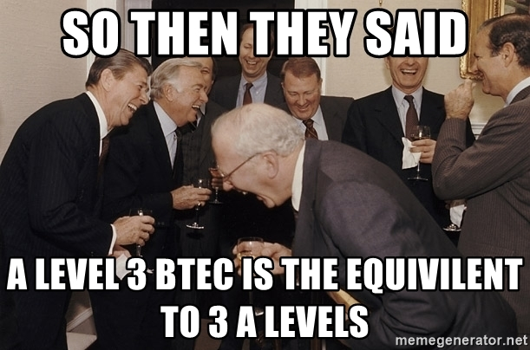
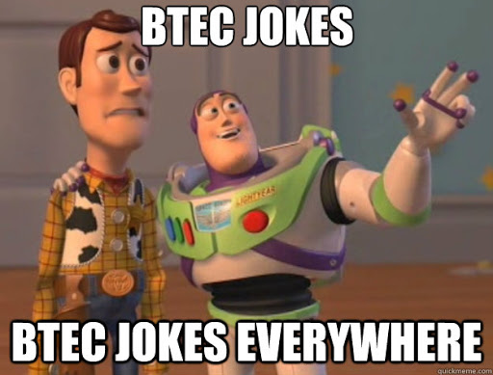
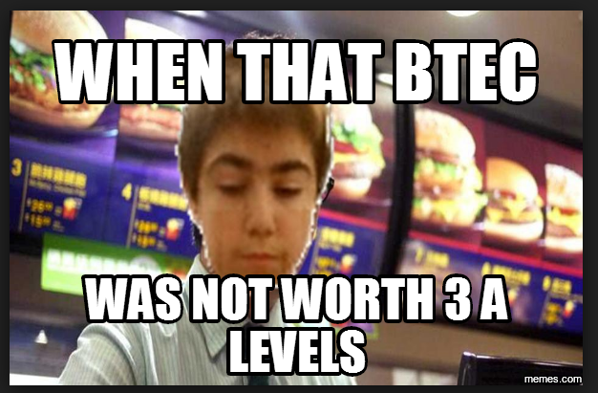
Common perceptions of BTEC

Slide 4
But what is a BTEC?
https://www.youtube.com/watch?v=uuyynIBDgeU

Slide 5
Differences between A Level and BTEC…
A Level | Level 3 BTEC
More theoretical | There is still research to do, reports to write, presentations to organise…
30% practical/coursework (Non-Exam Assessed work) | But this is much more practical and hands on
70% exam assessed work | 41% exam assessed work
Very individualised – sometimes can be isolating | A mixture and balance of individual, pair, and group work
More critical thinking is involved | More vocational skills are involved
Can lead to university

Slide 6
What does SJL offer?
BTEC Level 3 National Extended Diploma in Creative Digital Media Production - equivalent to 3 A Levels
BTEC Level 3 National Extended Certificate in Creative Digital Media Production – equivalent to 1 A Level (taken with 2 other options)
BTEC Level 3 National Extended Certificate in Business - equivalent to 1 A Level (taken with 2 other options)

Slide 7
Profiles
Toby Stewart
Didn’t go to university; started up how own production company – Crocodile Agency in Harpenden
Is now a successful CEO of a successful business
Has produced Snickers adverts, animations for Furniture Village, Alpro and Tango adverts as well as many social media campaigns.

Slide 8
Profiles
Tom Allen
Left 5 years ago
Achieved DDM
Received an unconditional offer
Went to Bournemouth University to study a Journalism degree

Slide 9
Profiles
Dylan Harvey
Left 2 years ago
Achieved D*D*D* (equivalent to A*A*A* at A Level)
Went to university to study a Media Production degree

Slide 10
Profiles
Zayn Kazmi
Left 2 years ago
Achieved DDM
Went to university to study a Law Degree

Slide 11
Ellie Panaman
Left 2 years ago
Achieved D*D*D
Studying a Media course at university
Was offered a bursary based on her achievement and portfolio work from the course.

Slide 12
Profiles
Toby Howe
Current Year 12/13 student
Achieved APS at GCSE
Is taking the BTEC Level 3 National Extended Diploma in Creative Digital Media Production - equivalent to 3 A Levels – BECAUSE HE WANTS TO!

Slide 13
Can I go to university?
YES!
Universities have learned that BTECs are a great alternative to A-Levels, and very few institutions won't consider BTEC students as candidates. Even Oxford and Cambridge include BTECs as part of their overall course requirements, although usually alongside other qualifications as well.
What University (2014)

Slide 14
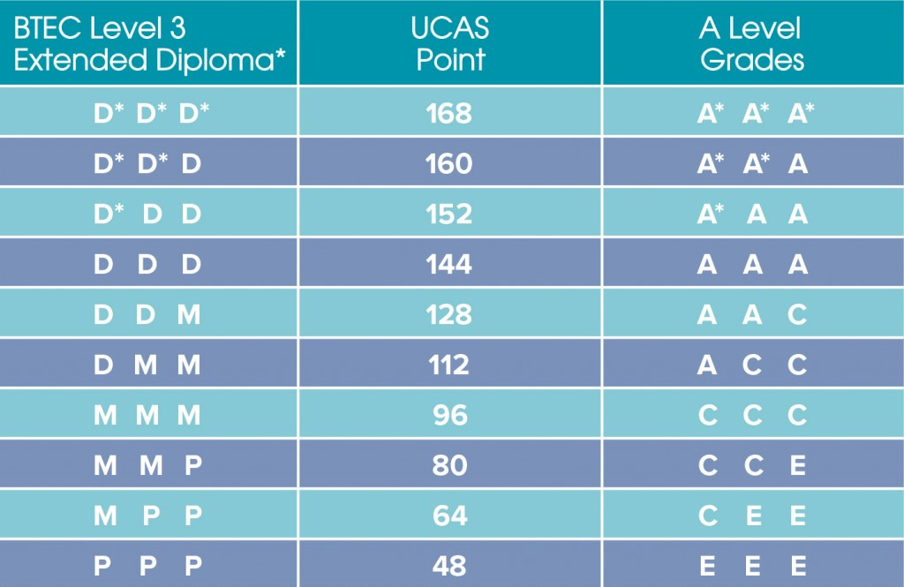
Can I go to university?
Some universities have been historically more focused on A-Levels as suitable entry requirements, but as the numbers of students studying BTECs has risen, the qualification has become more and more respected, and Edexcel now says over 100,000 BTEC students apply to university every year, with the number steadily rising all the time.

Slide 15
Choice!
1 Media Representations
2 Working in the Creative Media Industry
3 Digital Media Skills
4 Pre Production Portfolio
5 Specialist Subject Investigation
6 Media Campaigns
7 Media Enterprise
8 Responding to a Commission
9 App Production
10 Film Production – Fiction
11 Radio Production – Fiction
12 Website Production
13 Digital Games Production
14 Digital Magazine Production
15 Advertising Production
16 Factual Production
17 News Production
18 Storyboarding for Digital Media
19 Scriptwriting
20 Single Camera Techniques
21 Film Editing
22 Interviewing Techniques
23 Stop Motion Animation
24 Sound Editing
25 Sound Recording
26 Writing Copy
27 Digital Photography
28 Image Manipulation Techniques
29 2D Digital Graphics
30 Page Layout and Design for Digital Media
31 Coding for Web Based Media
32 Concept Art for Computer Games
33 2D Animation
34 Game Engine Scripting
35 Multi Camera Techniques
36 Lighting Techniques
37 Visual Effects
38 Sound Mixing
39 Live Radio Broadcasting
40 3D Modelling
41 3D Environments
42 Games Testing

Slide 16
Making up your mind…
BTEC isn’t for everybody; A Levels aren’t for everybody!
Think about where your strengths and interests lie
Don’t worry about what others think
Think about what you want to do in the future; /University? Apprenticeship? Employment?
Any questions – then please do come and ask!
Post-16 open evening + BTEC drop in lunchtime session to find out more – FM2 (TBC).

